Slide 1
Lecture 1: ECE/CS 4710 Sr. Project Design
Dr. Tsung-Wei Huang
Department of Electrical and Computer Engineering
University of Utah, Salt Lake City, UT
Notes:
Good morning, everyone. Welcome to CS 3992 Computer Engineering Senior Project Design. I am the course instructor Tsung-Wei Huang, and you can just call me TW, which is much easier to remember.
I am faculty member at the ECE department and my research helps parallel programming easier to handle. And, thanks for taking this course and I believe everyone is forced to do that.
I believe it is quite challenging this semester because I know many of you are suffering from the difficult situations due to COVID-19. The course is going to be in-person because we need you to be here to know each other so you can form teams. Its very difficult to find a team member without sitting in a room to know each other.
Keep in mind, we will need to follow the COVID-19 policy imposed by the university. This means, you need to wear masks and keep social distance.

Slide 2
Course Description
This course is for students with CE major who are seniors within one year of graduation. In this course, you (team) need to complete the design of an engineering you have proposed in 3992 last Spring semester. The fully functional project is demonstrated at the end of the semester.
Three major goals
Identify, formulate, and solve engineering problems.
Design a system, component, process, or software package to meet a specification.
Function on a multi-disciplinary team in various roles

Slide 3
Class Logistics
Staff
Instructor: T-W Huang (tsung-wei.huang@utah.edu) and Ken Stevens (kstevens@ece.utah.edu)
TA: Cheng-Hsiang Chiu (u1305418@utah.edu)
Class schedule
12:15 PM – 13:45 PM Tu/Th at MEB 3143
Lecture only this week!
Friday will have each team give a pitch
Weekly project meeting starting next week
The class will be mostly in-person project meeting
We can accommodate zoom if you need
Sign up your slot here: https://docs.google.com/spreadsheets/d/1wXqXjKIsvy4jrRFdygoRJFNKM5Lz3bVM674V4YcjLks/edit?usp=sharing
Notes:
class logistics. We have only one instructor and that is me. We will have one TA, Yasin; Yasin, would you please say hello to everyone and introduce yourself? I have put down our emails so you can reach out to us if you have any questions.
The main class takes place twice weekly. We will not have lectures all the week but in the first several weeks when I need to introduce the ideas of the course, ask you to give elevator pitch to let other students know you more, and present your proposal.
Most of the time will be offline and scheduled individual group meeting for me to understand your progress and give you advice.
You can find me at my office MEB 2124, pretty much every day I will be there. You can also email me to schedule an appointment so we can meet in person or do it virtually through zoom.
Webpage. We will use GitHub to manage the class. You can go visit the page or find the link at the my website. You can check out the class materials from the repository. We use GitHub because it allows everybody to easily keep track of all changes and updates to the class materials.

Slide 4
Scoring
Final demo day (60%)
Each team needs to give a demo (around the final week) + video recording
Stick with your 3992 proposal! (it is not wise to change the topic at this moment)
Weekly report (30%)
Design review with instructor of individual technical contribution (weekly meeting + report)
Final report documentation (10%)
Extended from your 3992 final proposal
Team grade
Notes:
In terms of scoring, there will be a total of 100 points going to assignment. Since this is a project-driven course, all the assignments are designed to be eventually helping you complete the project. Most of them are discussion-based, and I don’t think there is a way or a necessity to cheat.
We have totally seven items to your final grade.

Slide 5
Three Types of Deadlines
Weekly report after project meeting
Due 23:59 PM every Sunday, except fall break (Oct 10-17) and Thanksgiving break week (Nov 22-28)
Demo day to present your project (around Dec 8)
Each team needs to participate in project demo
Each team needs to record a 15-20 min video
Final report (one week after the demo day)
Each team needs to turn in the final report within a week of the demo day
Each team member needs to submit a peer evaluation form separately to the instructor

Slide 6
Peer Evaluation Form Sample
====== Evaluation Form: On a scale of 1 to 12, grade each of the members of your group including yourself for their overall contribution to the project. Consider a score of 10 as a perfect grade, and 12 going far beyond the call of duty - an effort worthy of extra credit. Be as objective as possible.
INCLUDE YOURSELF AS A TEAM MEMBER:
Name of team member #1:
Name of team member #2:
Name of team member #3:
Briefly describe the contributions of each team member (including yourself) and provide a short but critical justification of the score you gave them:

Slide 7
Let’s Look at Some 2020 Outcomes
Lego Battle Bots
https://www.youtube.com/watch?v=hvWqNdt5L90
Autonomous Sailing Across the Salt Lake
https://www.youtube.com/watch?v=eKXr_Y2f4zE
A Smart Home Gym
https://www.youtube.com/watch?v=HHGH5g19fS4
Notes:
The best way to understand what you need to accomplish in this two-semester-long course is to look at the outcome from previous students.

Slide 8
Current Project List from 3992
MercuryMesh: P2P Network for Autonomous Vehicles
Smart Chessboard
Smart Bike Kit
HealthyBois (Heart Strawng 💖🥤) - Health Monitering App w/ Water intake and Heart rate tracking
Zoom Peripheral
Holofan
VectorU: Active thrust vectoring at model rocket scale
UGuard
Textable Walkie-Talkies - TxTy
Thesis: An assessment of the impact of unregulated transmissions on Intelligent Transportation System communications at 5.9GHz
Thesis: Smart Helmet
Notes:
Now, I would like to explain briefly each assignment in the following slides. Keep in mind, each assignment is designed to help you more understand what you need to do and give you enough equipment and power to accomplish your senior design project.
Assignment 1: Engineering evaluation, due next Wed 11:59 pm. This assignment has two parts, part 1 is to identiy …
The idea is: Engineers improve the life of those in the world around them by improving interfaces, adding capabilities, and fixing things that are broken. For this assignment you will observe the every day world around you and determine what you, as a computer engineer, could do to improve it. Carry a note pad or cell phone and make notes of all the things that you observe over the next week. Turn in a report of identifying the improvement and sketch out your initial thoughts on how you would engineer a solution. The solutions should be realistic and feasible. Practice problem solving at a high level of abstraction and general project planning.
You will be graded on the problems set you identify, the problems having engineering solutions that you can identify, and your ability to define a reasonable project solution approach and effort estimate.

Slide 9
Weekly Report this Week
On Thursday, each team present three-page slides
Page 1: Project description (what/why)
Page 2: Team member and responsibility (who)
Page 3: Execution plan this semester (how)
Each team aims for about 5 mins
Sign up here: https://docs.google.com/spreadsheets/d/1wXqXjKIsvy4jrRFdygoRJFNKM5Lz3bVM674V4YcjLks/edit?usp=sharing
Email your slides to the TA (u1305418@utah.edu) by 11 AM Thursday (8/26)
Goal of presentation
Refresh your mind about your project idea
Let the instructor know your execution plan
Notes:
Create a short resume and quick elevator speech (no slides) that describe why other students in the senior project section would want to "hire" you into their team. Include the engineering skills that you enjoy and that you feel you excel at. You may also want to include areas where you have interest in growth and learning. List any time or accessibility constraints you might have. These would include that you already have a team and your project is half done, you have a work schedule that limits availability, etc. Also, provide a quick overview of interesting design ideas that you are keen to pursue.

Slide 10
Weekly Meeting Next Week
Sign up your weekly meeting slot here: https://docs.google.com/spreadsheets/d/1wXqXjKIsvy4jrRFdygoRJFNKM5Lz3bVM674V4YcjLks/edit?usp=sharing
By default, each team has 20 mins
By default, we meet at MEB 3143
Please indicate in the worksheet if you want to do zoom
First report due: 23:59 PM on 9/6 (Sunday)

Slide 11
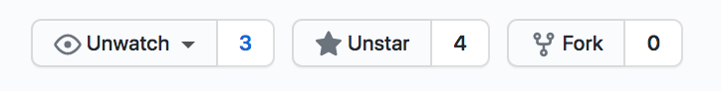
Please Bookmark the Two Links
https://github.com/tsung-wei-huang/ece4710
You can receive all updates
New announcement
New check-in data
New updates
No GitHub account…? (you must be kidding me)
We will use the google worksheet most of the time: https://docs.google.com/spreadsheets/d/1wXqXjKIsvy4jrRFdygoRJFNKM5Lz3bVM674V4YcjLks/edit?usp=sharing
Notes:
I kindly ask everyone of you to register for a GitHub account. Once you register for a GitHub account, you can log in your page, go to the class GitHub page, and watch the repository. You will be able to see a link on the top-right page for you to click on to watch the page so you can receive all updates, including ...
It is very important you get familiarized with the GitHub. This is probably the most popular open source repository for you to store your software and hardware project. And GitHub provides many easy access to, for example, keep track of progress, updates, modification, and so on. We will also ask you later on to create personal pages for your resume and set up a project repository in GitHub.
Everything in GitHub is free.
For assignment, you will need to turn in them through Canvas because Canvas requires log in and we can keep many data confidential like your grades.

Slide 12
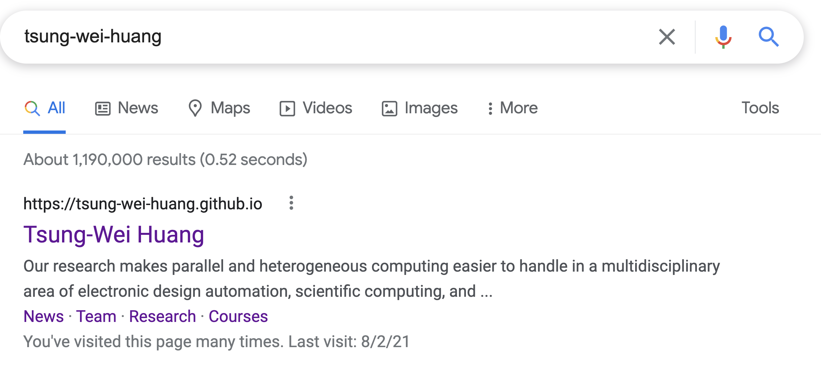
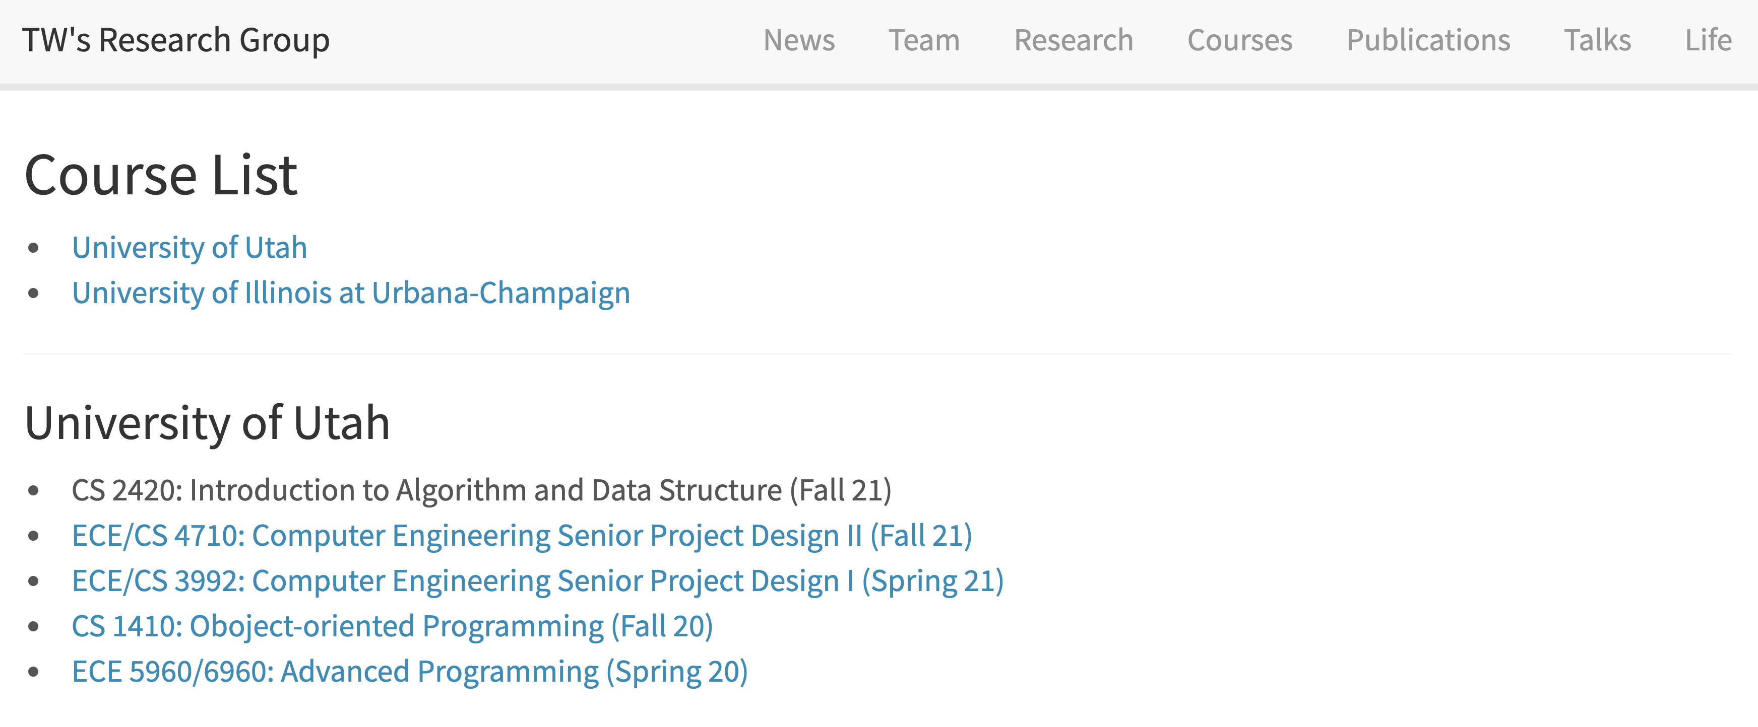
You Can Find the Link at My Page
Notes:
I kindly ask everyone of you to register for a GitHub account. Once you register for a GitHub account, you can log in your page, go to the class GitHub page, and watch the repository. You will be able to see a link on the top-right page for you to click on to watch the page so you can receive all updates, including ...
It is very important you get familiarized with the GitHub. This is probably the most popular open source repository for you to store your software and hardware project. And GitHub provides many easy access to, for example, keep track of progress, updates, modification, and so on. We will also ask you later on to create personal pages for your resume and set up a project repository in GitHub.
Everything in GitHub is free.
For assignment, you will need to turn in them through Canvas because Canvas requires log in and we can keep many data confidential like your grades.

Slide 13
Paid Undergraduate Research Assistant
I am looking for a undergraduate research assistant who is interested in software programming and building parallel algorithms for computer engineering applications
The position will be paid with an hourly rate up to 20 hours a week over the fall semester
This past summer two of you worked with me and we submitted a research paper to a conference
Background needed
Self-motivated (this is an opportunity to grow yourself)
C++ programming
Talk to or email me (with your CV) if you are interested!

